Slide 1

BSBXCS402 Promote workplace cyber security awareness
Review cyber security awareness in work place

Slide 2
CyberSecurity
This session will investigate:
Reviewing Cyber Security threats and trends
Document outcomes of review and suggested improvements
Communicate review and suggestions according to organisation policies and procedures

Slide 3
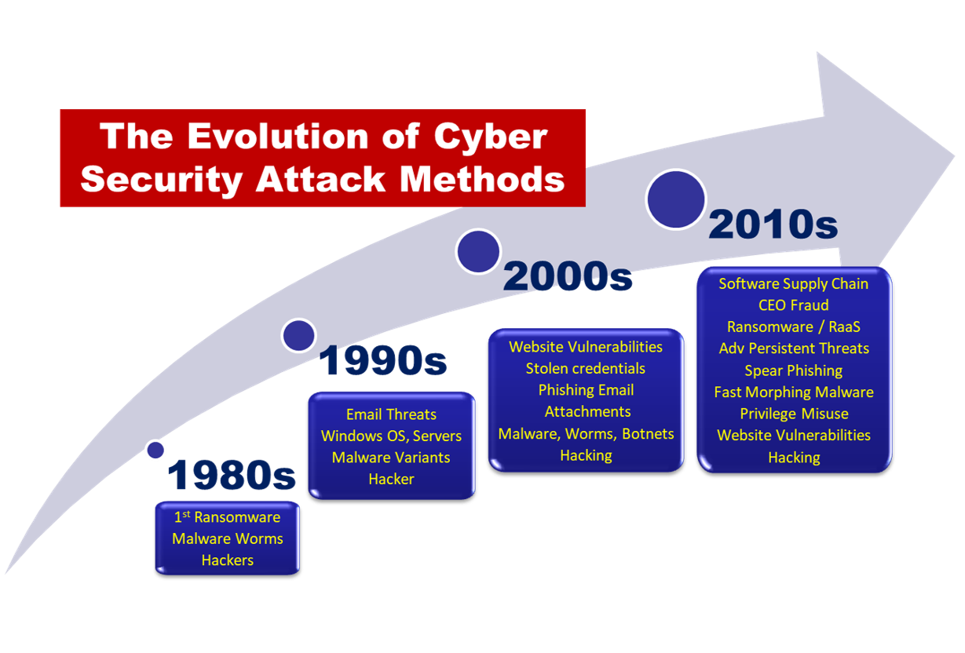
Latest cyber threats and trends
Notes:
Attendance = is recorded against a particular session/class, hence the student must be registered in a Class in order for attendance to be recorded.
Engagement = (also referred to as attendance and participation in Ci Desktop) refers to a student's involvement in study where the student is not attending a defined class. This may be due to completing study in the workplace or on-the -job as an apprentice or trainee

Slide 4
Trends
The risk and severity of cyber attacks continues to grow
Global cybercrime costs are expected to grow to $10.5 trillion USD annually by 2025, up from $3 trillion USD in 2015.
This represents the greatest transfer of economic wealth in history, risks the incentives for innovation and investment, is exponentially larger than the damage inflicted from natural disasters in a year, and will be more profitable than the global trade of all major illegal drugs combined.
Notes:
Attendance = is recorded against a particular session/class, hence the student must be registered in a Class in order for attendance to be recorded.
Engagement = (also referred to as attendance and participation in Ci Desktop) refers to a student's involvement in study where the student is not attending a defined class. This may be due to completing study in the workplace or on-the -job as an apprentice or trainee

Slide 5
Trends
Nov. 13, 2020
If it were measured as a country, then cybercrime — which is predicted to inflict damages totaling $6 trillion USD globally in 2021 — would be the world’s third-largest economy after the U.S. and China.
Notes:
Attendance = is recorded against a particular session/class, hence the student must be registered in a Class in order for attendance to be recorded.
Engagement = (also referred to as attendance and participation in Ci Desktop) refers to a student's involvement in study where the student is not attending a defined class. This may be due to completing study in the workplace or on-the -job as an apprentice or trainee

Slide 6
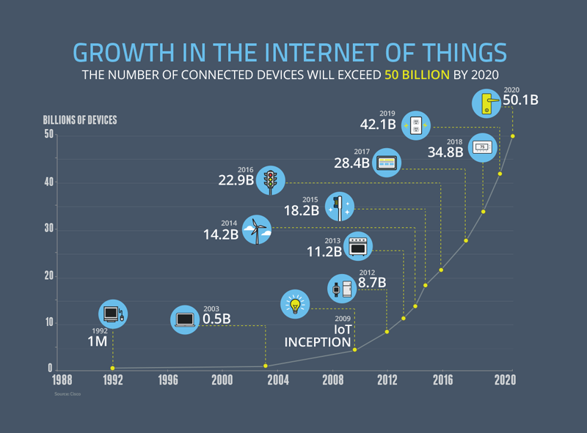
Trends in technology
Behind The Numbers: Growth in the Internet of Things | NCTA — The Internet & Television Association
Notes:
Attendance = is recorded against a particular session/class, hence the student must be registered in a Class in order for attendance to be recorded.
Engagement = (also referred to as attendance and participation in Ci Desktop) refers to a student's involvement in study where the student is not attending a defined class. This may be due to completing study in the workplace or on-the -job as an apprentice or trainee

Slide 7
Trends
The world is shifting to IOT and cloud devices.
Both technologies introduce new cyber security risks to an organisation
Notes:
Attendance = is recorded against a particular session/class, hence the student must be registered in a Class in order for attendance to be recorded.
Engagement = (also referred to as attendance and participation in Ci Desktop) refers to a student's involvement in study where the student is not attending a defined class. This may be due to completing study in the workplace or on-the -job as an apprentice or trainee

Slide 8
IOT
Businesses are quickly adopting IoT devices due to high potential for savings. For example, after Harley-Davidson turned their Pennsylvania plant to a ‘smart factory’ using IoT devices in every step of the production process, they reduced costs by 7% and increased net margin by 19%.
Notes:
Attendance = is recorded against a particular session/class, hence the student must be registered in a Class in order for attendance to be recorded.
Engagement = (also referred to as attendance and participation in Ci Desktop) refers to a student's involvement in study where the student is not attending a defined class. This may be due to completing study in the workplace or on-the -job as an apprentice or trainee

Slide 9
IOT
Since IoT devices are connected to the internet, they can be hacked just like any other internet-enabled device.
One of the key IoT security issues is the expansion of attack surfaces due to an increased number of endpoints.
Notes:
Attendance = is recorded against a particular session/class, hence the student must be registered in a Class in order for attendance to be recorded.
Engagement = (also referred to as attendance and participation in Ci Desktop) refers to a student's involvement in study where the student is not attending a defined class. This may be due to completing study in the workplace or on-the -job as an apprentice or trainee

Slide 10
IOT
Since IoT devices are connected to the internet, they can be hacked just like any other internet-enabled device.
One of the key IoT security issues is the expansion of attack surfaces due to an increased number of endpoints.
Notes:
Attendance = is recorded against a particular session/class, hence the student must be registered in a Class in order for attendance to be recorded.
Engagement = (also referred to as attendance and participation in Ci Desktop) refers to a student's involvement in study where the student is not attending a defined class. This may be due to completing study in the workplace or on-the -job as an apprentice or trainee

Slide 11
Cloud
Cloud computing has a number of advantages
Cost Savings.
Back-up and restore data. ...
Automatic Software Integration. ...
Reliability. ...
Mobility. ...
Unlimited storage capacity. ...
Collaboration. ...
Quick Deployment.
Notes:
Attendance = is recorded against a particular session/class, hence the student must be registered in a Class in order for attendance to be recorded.
Engagement = (also referred to as attendance and participation in Ci Desktop) refers to a student's involvement in study where the student is not attending a defined class. This may be due to completing study in the workplace or on-the -job as an apprentice or trainee

Slide 12
Cloud
Cloud computing has a number of security risks:
User Account Hijacking –. Account Hijacking is the most serious security issue in Cloud Computing. ...
Changing Service Provider –. Vendor lock In is an important Security issue in Cloud Computing. ...
Denial of Service (DoS) attack –. This type of attack occurs when the system receives too much traffic. ..
Notes:
Attendance = is recorded against a particular session/class, hence the student must be registered in a Class in order for attendance to be recorded.
Engagement = (also referred to as attendance and participation in Ci Desktop) refers to a student's involvement in study where the student is not attending a defined class. This may be due to completing study in the workplace or on-the -job as an apprentice or trainee

Slide 13
New cyber threats
Artificial Intelligence and machine learning have led to :
AI fuzzing : uses artifical intelligence to create a tool for detecting system vulnerabilities (useful for defenders as well as attackers)
Blockchain: businesses are increasingly using blockchain technologies for digital asset exchange. The relative 'newness' of this technology makes it vulnerable to cyber criminals
Notes:
Attendance = is recorded against a particular session/class, hence the student must be registered in a Class in order for attendance to be recorded.
Engagement = (also referred to as attendance and participation in Ci Desktop) refers to a student's involvement in study where the student is not attending a defined class. This may be due to completing study in the workplace or on-the -job as an apprentice or trainee

Slide 14
New cyber threats
Social engineering attacks like phishing are effective, high reward and low risk for hackers.
Phishing remains the number one cause of data breaches globally
Notes:
Attendance = is recorded against a particular session/class, hence the student must be registered in a Class in order for attendance to be recorded.
Engagement = (also referred to as attendance and participation in Ci Desktop) refers to a student's involvement in study where the student is not attending a defined class. This may be due to completing study in the workplace or on-the -job as an apprentice or trainee

Slide 15

New cyber threats
Deepfake – AI technology allows for increasingly convincing images and videos
Notes:
Attendance = is recorded against a particular session/class, hence the student must be registered in a Class in order for attendance to be recorded.
Engagement = (also referred to as attendance and participation in Ci Desktop) refers to a student's involvement in study where the student is not attending a defined class. This may be due to completing study in the workplace or on-the -job as an apprentice or trainee

Slide 16
Business impacts
Top 5 business impacts of cyber threats:
(note different industry's are impacted differently depending on their product, attack surface, reliance on reputation etc.)
Notes:
Attendance = is recorded against a particular session/class, hence the student must be registered in a Class in order for attendance to be recorded.
Engagement = (also referred to as attendance and participation in Ci Desktop) refers to a student's involvement in study where the student is not attending a defined class. This may be due to completing study in the workplace or on-the -job as an apprentice or trainee

Slide 17
Business impacts
Reputation damage – loss of customer confidence equates to share price loss, loss of revenue, loss of ability to attract best talent, suppliers and investors.
Some businesses eg Ashley Madison Online dating site, were completely destroyed after a data breach
Notes:
Attendance = is recorded against a particular session/class, hence the student must be registered in a Class in order for attendance to be recorded.
Engagement = (also referred to as attendance and participation in Ci Desktop) refers to a student's involvement in study where the student is not attending a defined class. This may be due to completing study in the workplace or on-the -job as an apprentice or trainee

Slide 18
Business impacts
Theft – Stolen data can be a considerable motivation for hackers, and lead to considerable monetary loss for a business.
2020 Cybercrime costs the world more than $1 trillion, a 50% increase from 2018 Cybercrime costs the world economy more than $1 trillion, or just more than one percent of global GDP, which is up more than 50 percent from a 2018 study that put global losses at close to $600 billion, McAfee reveals.
Notes:
Attendance = is recorded against a particular session/class, hence the student must be registered in a Class in order for attendance to be recorded.
Engagement = (also referred to as attendance and participation in Ci Desktop) refers to a student's involvement in study where the student is not attending a defined class. This may be due to completing study in the workplace or on-the -job as an apprentice or trainee

Slide 19
Business impacts
Fines: The European Union has introduced the GDPR which can fine a company up to 4 % of global revenue if a European citizen's personal information is breached.
Notes:
Attendance = is recorded against a particular session/class, hence the student must be registered in a Class in order for attendance to be recorded.
Engagement = (also referred to as attendance and participation in Ci Desktop) refers to a student's involvement in study where the student is not attending a defined class. This may be due to completing study in the workplace or on-the -job as an apprentice or trainee

Slide 20
Recommended improvements
The Australian Cyber Security Centre recommends the Essential 8
https://www.cyber.gov.au/
Notes:
Attendance = is recorded against a particular session/class, hence the student must be registered in a Class in order for attendance to be recorded.
Engagement = (also referred to as attendance and participation in Ci Desktop) refers to a student's involvement in study where the student is not attending a defined class. This may be due to completing study in the workplace or on-the -job as an apprentice or trainee

Slide 21
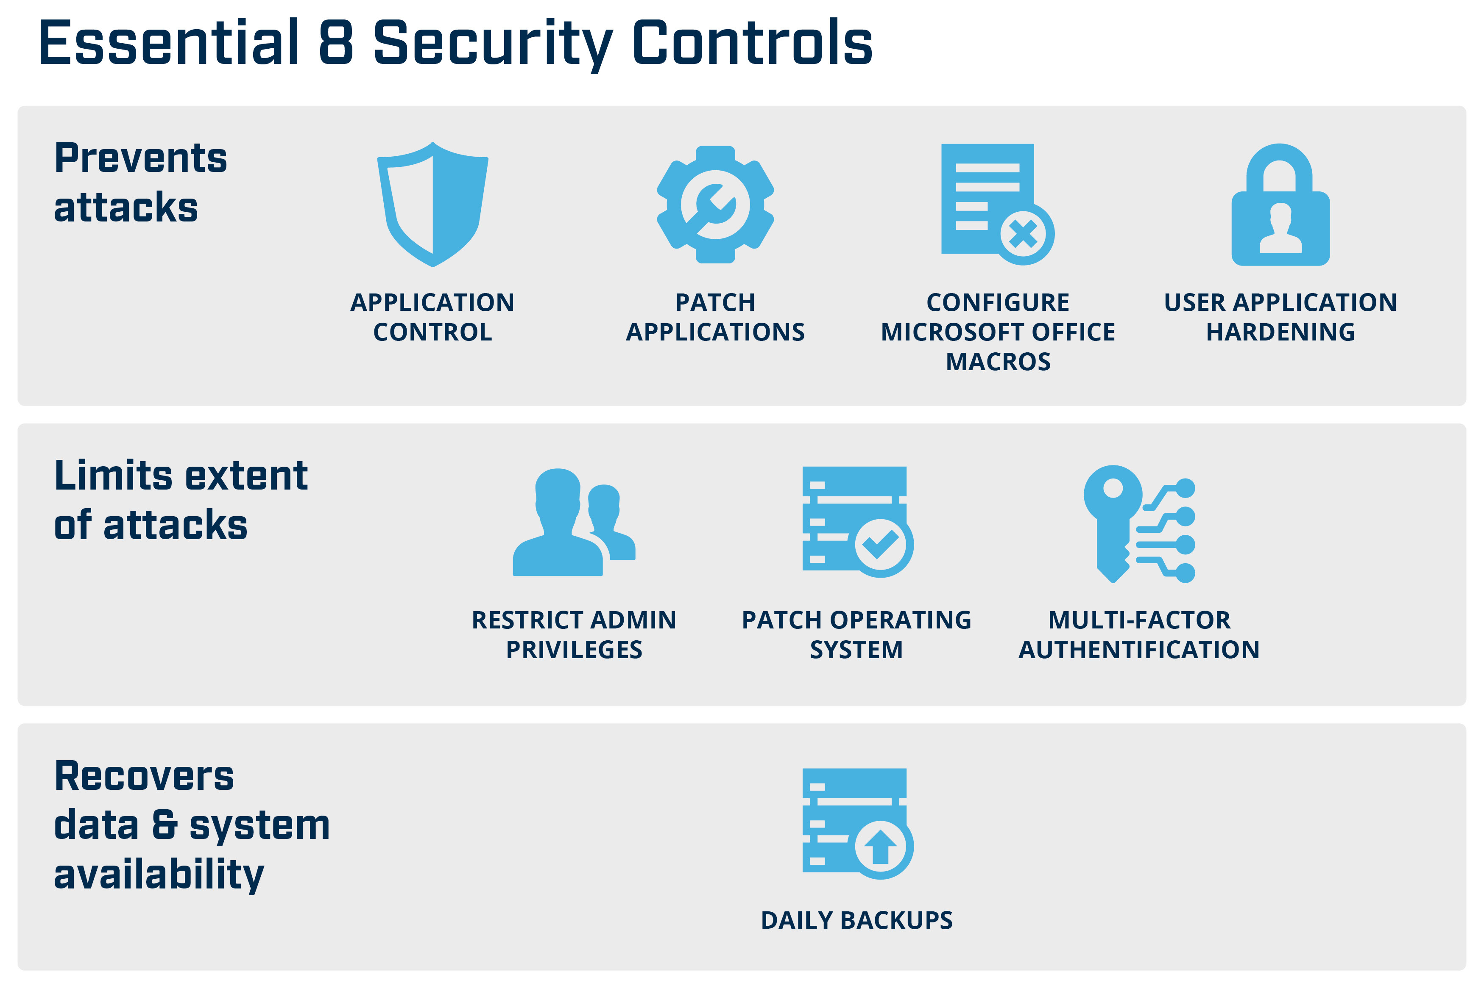
Recommendations
Notes:
Attendance = is recorded against a particular session/class, hence the student must be registered in a Class in order for attendance to be recorded.
Engagement = (also referred to as attendance and participation in Ci Desktop) refers to a student's involvement in study where the student is not attending a defined class. This may be due to completing study in the workplace or on-the -job as an apprentice or trainee

Slide 22
Communicating
We need to be able to communicate the results of our cyber security reviews, and make suggestions for improvement to the organisation's security (eg Essential 8).
Notes:
Attendance = is recorded against a particular session/class, hence the student must be registered in a Class in order for attendance to be recorded.
Engagement = (also referred to as attendance and participation in Ci Desktop) refers to a student's involvement in study where the student is not attending a defined class. This may be due to completing study in the workplace or on-the -job as an apprentice or trainee

Slide 23
Communicating
4 main types of communication:
Verbal
Non verbal
Written
Visual
Notes:
Attendance = is recorded against a particular session/class, hence the student must be registered in a Class in order for attendance to be recorded.
Engagement = (also referred to as attendance and participation in Ci Desktop) refers to a student's involvement in study where the student is not attending a defined class. This may be due to completing study in the workplace or on-the -job as an apprentice or trainee

Slide 24
Verbal
You can improve your verbal communication by:
Using a strong and confident speaking voice
Using active listening – avoid interrupting, summarize and repeat back
Avoid filler words – um, like, yeah, nah
Avoid technical language with a non-tehnical audience
Notes:
Attendance = is recorded against a particular session/class, hence the student must be registered in a Class in order for attendance to be recorded.
Engagement = (also referred to as attendance and participation in Ci Desktop) refers to a student's involvement in study where the student is not attending a defined class. This may be due to completing study in the workplace or on-the -job as an apprentice or trainee

Slide 25
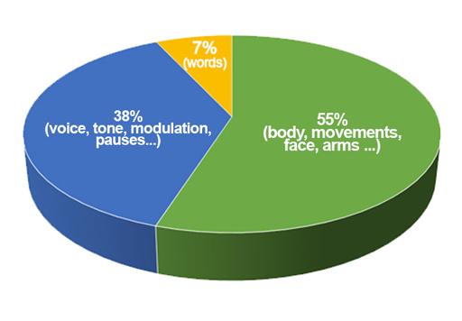
Non- Verbal
Non verbal communication is the use of body language, gestures and facial expressions to convey information
Notes:
Attendance = is recorded against a particular session/class, hence the student must be registered in a Class in order for attendance to be recorded.
Engagement = (also referred to as attendance and participation in Ci Desktop) refers to a student's involvement in study where the student is not attending a defined class. This may be due to completing study in the workplace or on-the -job as an apprentice or trainee

Slide 26
Non- Verbal
You can improve your non-verbal communication by:
Displaying positive body language
Use non-verbal communication like nodding to communicate approval and positive feedback
Notes:
Attendance = is recorded against a particular session/class, hence the student must be registered in a Class in order for attendance to be recorded.
Engagement = (also referred to as attendance and participation in Ci Desktop) refers to a student's involvement in study where the student is not attending a defined class. This may be due to completing study in the workplace or on-the -job as an apprentice or trainee

Slide 27
Written
In the workplace we use written communication in the form of emails, reports, letters, memos, books, documents and web sites. Written communication provides a record of information for reference.
Notes:
Attendance = is recorded against a particular session/class, hence the student must be registered in a Class in order for attendance to be recorded.
Engagement = (also referred to as attendance and participation in Ci Desktop) refers to a student's involvement in study where the student is not attending a defined class. This may be due to completing study in the workplace or on-the -job as an apprentice or trainee

Slide 28
Written
You can improve your written communication by:
Striving for simplicity and using clear and appropriate language
Avoid tone. When verbally communicating we can indicate a joke, sarcasm etc with our tone of voice. When writing we should keep to plain and simple.
Proof-read written communication to identify mistakes or opportunities to say something different
Notes:
Attendance = is recorded against a particular session/class, hence the student must be registered in a Class in order for attendance to be recorded.
Engagement = (also referred to as attendance and participation in Ci Desktop) refers to a student's involvement in study where the student is not attending a defined class. This may be due to completing study in the workplace or on-the -job as an apprentice or trainee

Slide 29
Visual
Visual communication is the act of using photographs, art, drawings, sketches, charts and graphs to convey information.
Because people have different learning styles, visual communication can be very helpful to communicate ideas and information. Especially in conjunction with written communication.
Notes:
Attendance = is recorded against a particular session/class, hence the student must be registered in a Class in order for attendance to be recorded.
Engagement = (also referred to as attendance and participation in Ci Desktop) refers to a student's involvement in study where the student is not attending a defined class. This may be due to completing study in the workplace or on-the -job as an apprentice or trainee

Slide 30

Visual
Notes:
Attendance = is recorded against a particular session/class, hence the student must be registered in a Class in order for attendance to be recorded.
Engagement = (also referred to as attendance and participation in Ci Desktop) refers to a student's involvement in study where the student is not attending a defined class. This may be due to completing study in the workplace or on-the -job as an apprentice or trainee

Slide 31
Visual
You can improve your visual communication by:
Selecting your visuals carefully (some might offend or confuse)
Consider your audience. Overly complicated visuals (eg charts) might distract from your message.
Notes:
Attendance = is recorded against a particular session/class, hence the student must be registered in a Class in order for attendance to be recorded.
Engagement = (also referred to as attendance and participation in Ci Desktop) refers to a student's involvement in study where the student is not attending a defined class. This may be due to completing study in the workplace or on-the -job as an apprentice or trainee

Slide 32
Corporate communication
Ways to communicate your cyber security review outcomes and improvements need to align with the corporate practices of your workplace.
Notes:
Attendance = is recorded against a particular session/class, hence the student must be registered in a Class in order for attendance to be recorded.
Engagement = (also referred to as attendance and participation in Ci Desktop) refers to a student's involvement in study where the student is not attending a defined class. This may be due to completing study in the workplace or on-the -job as an apprentice or trainee

Slide 33
Corporate communication
Encourage open discussion
When staff are encouraged to communicate openly, they feel valued and are more likely to give feedback and express opinions.
Notes:
Attendance = is recorded against a particular session/class, hence the student must be registered in a Class in order for attendance to be recorded.
Engagement = (also referred to as attendance and participation in Ci Desktop) refers to a student's involvement in study where the student is not attending a defined class. This may be due to completing study in the workplace or on-the -job as an apprentice or trainee

Slide 34
Corporate communication
Face to face
Whilst email is convenient, large volumes of emails can lead to a reduction in effectiveness of communication
It can be simpler and quicker to talk directly to a colleague via face-to-face conversation
Notes:
Attendance = is recorded against a particular session/class, hence the student must be registered in a Class in order for attendance to be recorded.
Engagement = (also referred to as attendance and participation in Ci Desktop) refers to a student's involvement in study where the student is not attending a defined class. This may be due to completing study in the workplace or on-the -job as an apprentice or trainee

Slide 35
Corporate communication
Be careful when wording emails
It's difficult to intepret 'tone' when reading an email eg sarcasm.
Brief emails can be ambiguous and confusing
Emails require proper spelling, punctuation and grammar (and they are a lasting digital record)
Notes:
Attendance = is recorded against a particular session/class, hence the student must be registered in a Class in order for attendance to be recorded.
Engagement = (also referred to as attendance and participation in Ci Desktop) refers to a student's involvement in study where the student is not attending a defined class. This may be due to completing study in the workplace or on-the -job as an apprentice or trainee

Slide 36
Corporate communication
Body language
You ought be aware of your body language and how people may react to it
You ought endeavour to communicate with a positive physical presence eg smiling, eye contact, uncrossed arms
Notes:
Attendance = is recorded against a particular session/class, hence the student must be registered in a Class in order for attendance to be recorded.
Engagement = (also referred to as attendance and participation in Ci Desktop) refers to a student's involvement in study where the student is not attending a defined class. This may be due to completing study in the workplace or on-the -job as an apprentice or trainee

Slide 37
Corporate communication
Meetings
Meetings should be held when necessary, not for the sake of it
Meetings should have an agenda, a time limit and a clear purpose
Notes:
Attendance = is recorded against a particular session/class, hence the student must be registered in a Class in order for attendance to be recorded.
Engagement = (also referred to as attendance and participation in Ci Desktop) refers to a student's involvement in study where the student is not attending a defined class. This may be due to completing study in the workplace or on-the -job as an apprentice or trainee

Slide 38
Corporate communication
Visuals
Relevant graphics can help to reinforce your messaging
Notes:
Attendance = is recorded against a particular session/class, hence the student must be registered in a Class in order for attendance to be recorded.
Engagement = (also referred to as attendance and participation in Ci Desktop) refers to a student's involvement in study where the student is not attending a defined class. This may be due to completing study in the workplace or on-the -job as an apprentice or trainee

Slide 39
Questions
What are the latest cyber security threats and trends?
What are the recommendations to prevent cyber attacks?
Notes:
Attendance = is recorded against a particular session/class, hence the student must be registered in a Class in order for attendance to be recorded.
Engagement = (also referred to as attendance and participation in Ci Desktop) refers to a student's involvement in study where the student is not attending a defined class. This may be due to completing study in the workplace or on-the -job as an apprentice or trainee

